Slide 1
UMET9G-30-1 Accounting & Finance for Decision Making Time Value of Money – Part 1
Lecture 2

Slide 2

Recap
Last weeks session covered:
The role of ratios
Key ratios within Gearing, Liquidity & efficient
Calculation and interpretation
Notes:
NOTE TO STUDENTS: Please see last weeks lecture slides and make sure you review them so that you understand how you will be assessed and what resources we provide to support you in success.

Slide 3
Learning Outcomes
Understand the concept of time in finance
The present value and discounting
The future value and compounding
Simple vs Compounding Interest
Notes:
The concept of time in finance
Simple vs Compounding Interest
The present value and discounting
The future value and compounding

Slide 4
Recap from the Introduction Lecture
Last week:
The Financial System
Company structures
The role of finance
Financial Principles
Primary Objective –to maximise Shareholder Value

Slide 5
Capital budgeting
Corporate Finance
Investment Decision
Financing Decision
Liquidity
Capital Budgeting
You buy goods from a Chinese supplier for CN¥5,000 (yuan) and sells them immediately in the UK for £700 (GBP). Is this a profitable transaction?
Who knows. First must convert inflows and outflows TO A COMMON CURRENCY.
A company is considering updating it’s IT system at a cost of £80k. Efficiency savings are expected to be £15k each year for the next 5 years. Are the costs associated with investment outweighed by the benefits?
Cash flows happening at different timepoints are similar to cash flows in different currencies. So, we must convert the inflows and outflows TO A COMMON TIMEPOINT.
Notes:
Use a market rate to convert across currencies, can use a market interest rate to convert it across points in time too.

Slide 6
Time Value of Money
Your bank offer you £100 cashback reward on your recent purchases. However, you can choose when to redeem it; today or a year from now. Which would you choose?
Most people will choose £100 today because the Time value of money, the simple notion that a pound today is preferable to a pound in the future.
Other things remaining equal
The preference for current consumption
The value of future cash flows
Expected inflation
The value of future cash flows
The uncertainty in the cashflow
The value of future cash flows
To induce you to give up present consumption, to compensate you for the loss of purchasing power, and to tempt you to take the risk, the bank should offer you MORE in the future.
Notes:
Consumption Preference – individuals prefer present to future consumption
You can deposit those £100 today and earn interest on them
You are unsure about the future quality/availability of goods and services
Monetary Inflation – the value of currency decreases over time due to inflation
Inflation reduces the purchasing power of money
higher the inflation expected, the less goods and services you could buy in the future
Risk – the uncertainty associated with the cash flows decreases their value
The promised cash flow might not be delivered if, for example, the bank defaults, you miss the redemption date…
Risk decreases the likelihood of receiving the cash flow

Slide 7
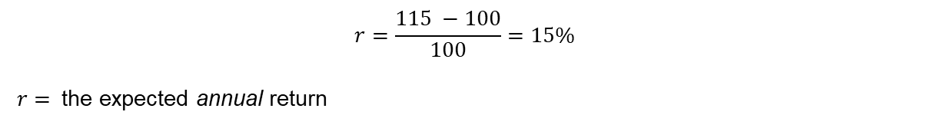
Time Value of Money
Suppose you decide that £15 will compensate you for delaying consumption, inflation and risk. How will your choice change if the bank offered you £100 today vs £115 in a year?
$⇒$ You would be indifferent.
$⇒$The additional £15 would put the same position in 1 year as your position today.
The extra £15 is your expected cash return from foregoing £100 today to collect your cash flow after 1 year. It compensates you for delaying consumption, bearing inflation and taking risk.
$$r=\frac{115 −100}{100}=15\%$$
$r=$ the expected annual return

Slide 8






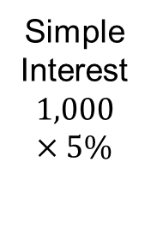



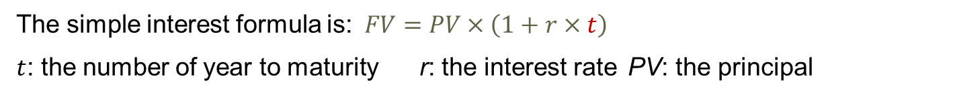






















Simple Interest
You have a 5 year investment plan, offering annual interest rate of 5%. What will your £1k be in 5 years if this is based on simple interest. Let’s look at the cashflow timeline:
$$£50$$
$$£50$$
$$£50$$
Simple Interest
$$1,000×5\%$$
$$5×£50=£250$$
$$£50$$
$$£50$$
$$£50$$
$$£50$$
$$£50$$
$$£50$$
$$£50$$
$$£50$$
$$£50$$
$$£50$$
$$£50$$
$$£50$$
$$+$$
$$£1,000$$
$$£1,000$$
$$£1,000$$
$$£1,000$$
$$£1,000$$
$$£1,000$$
$$£1,000$$
$$=$$
$$£1,250$$
$$t=0$$
$$t=1$$
$$t=2$$
$$t=3$$
$$t=4$$
$$t=5$$
Principal
Future Value
The simple interest formula is:$FV=PV×\left(1+r×t\right)$
$t$: the number of year to maturity r: the interest rate PV: the principal
Notes:
$$FV=1,000+1,000×5\%×5=1,000×\left(1+5\%×5\right)=£1,250$$
Only earn interest on the principle

Slide 9





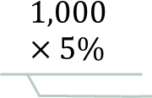


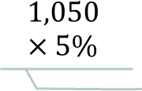













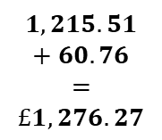









Compound Interest
$$1,215.51×5\%$$
Same 5 year, 5% investment plan but with annual compound interest
$$1,157.63×5\%$$
$$£60.76$$
$$1,102.5×5\%$$
$$£57.88$$
$$£57.88$$
$$1,050×5\%$$
$$£55.13$$
$$£55.13$$
$$£55.13$$
$$1,000×5\%$$
$$£52.5$$
$$£52.5$$
$$£52.5$$
$$£52.5$$
$$1,215.51$$
$$+ 60.76$$
$$=$$
$$£1,276.27$$
$$£50$$
$$£50$$
$$£50$$
$$£50$$
$$£50$$
Future Value
$$£1,000$$
$$£1,000$$
$$£1,000$$
$$£1,000$$
$$£1,000$$
$$£1,000$$
Principal
$$t=0$$
$$t=1$$
$$t=2$$
$$t=3$$
$$t=4$$
$$t=5$$
Notes:
Now earning interest on the interest

Slide 10











Compound Interest
$$£1,000$$
$$×$$
$${\left(1+5\%\right)}^{4}$$
$$×$$
$$(1+5\%)$$
$$=£1,000$$
$$×$$
$${\left(1+5\%\right)}^{5}$$
Scheme 1: a 5-year plan with an annual compound interest rate of 5%.
$$£1,000$$
$$×$$
$${\left(1+5\%\right)}^{3}$$
$$×$$
$$(1+5\%)$$
$$=£1,000$$
$$×$$
$${\left(1+5\%\right)}^{4}$$
$$£1,000$$
$$×$$
$${\left(1+5\%\right)}^{2}$$
$$×$$
$$(1+5\%)$$
$$=£1,000$$
$$×$$
$${\left(1+5\%\right)}^{3}$$
$$£1,000$$
$$×$$
$$(1+5\%)$$
$$×$$
$$(1+5\%)$$
$$=£1,000$$
$$×$$
$${\left(1+5\%\right)}^{2}$$
$$£1,000$$
$$×$$
$$(1+5\%)$$
$$£1,000$$
$$t=0$$
$$t=1$$
$$t=2$$
$$t=3$$
$$t=4$$
$$t=5$$
The future value of the initial £1,000:$FV=PV×{\left(1+5\%\right)}^{5}=1,000×{\left(1+5\%\right)}^{5}=£1,276.38$

Slide 11
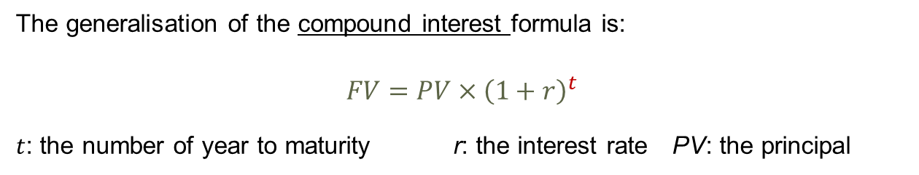
Compound Interest
The generalisation of the compound interest formula is:
$$FV=PV×{\left(1+r\right)}^{t}$$
$t$: the number of year to maturity r: the interest rate PV: the principal

Slide 12
Time Value of Money
When we take a present value to the future, this is called compounding. Therefore$r$ is known as the compound rate. Eg for simple interest
$$FV=PV×\left(1+r\right)$$
Rearranging this formula, the present value (PV) of a cash flow happening in a year can be calculated as:
$$PV=FV×{\left(1+r\right)}^{−1}$$
In the latter, we are bringing a future value back to the present, i.e. discounting. Therefore $r$ is the discount rate.

Slide 13

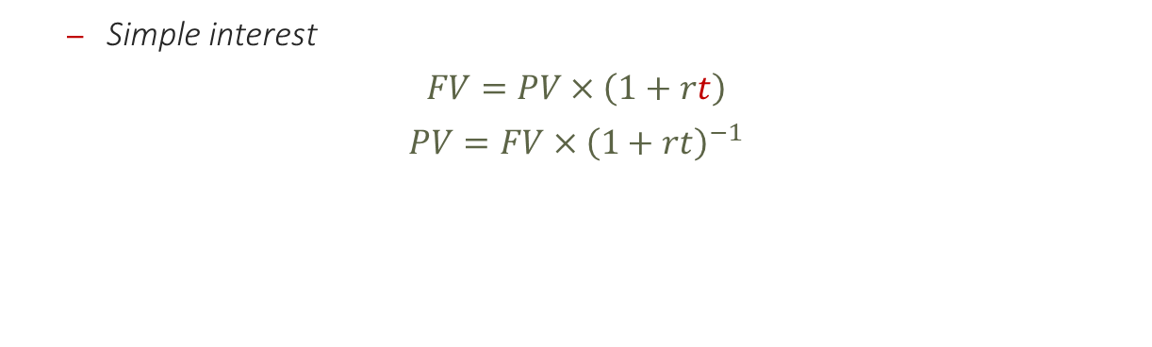
TVM formulae - Roundup
Simple interest
$$FV=PV×\left(1+rt\right)$$
$$PV=FV×{\left(1+rt\right)}^{−1}$$
Compound interest
$$FV=PV×{\left(1+r\right)}^{t}$$
$$PV=FV×{\left(1+r\right)}^{−t}$$

Slide 14


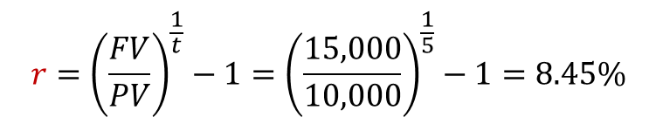
TVM - $r$
What if you knew the present and future values and you wanted to know the interest rate? Or the number of years? Let’s rearrange the formulae…
Example
Your broker suggests the following two “guaranteed” investment plans, each require a £10k principal:
Investment 1: offers you £15k in 5 years.
Investment 2: offers you £22k in 10 years.
Now we will always assume compound interest rates…
What is the annual rate of return of each plan? The r.
$${r=\left(\frac{FV}{PV}\right)}^{\frac{1}{t}}$$
$${r=\left(\frac{FV}{PV}\right)}^{\frac{1}{t}}−1={\left(\frac{15,000}{10,000}\right)}^{\frac{1}{5}}−1=8.45\%$$

Slide 15


TVM - $t$
Now you want to know the time element…..
Example: You have a £10k deposit in your savings account, in which you earn 5% compound interest. You want to figure out how long it would take you to reach 2 targets.
Target 1: double your principal.
Target 2: triple your principal.
$$t=\frac{\ln\left(\frac{FV}{PV}\right)}{ln⁡(1+r)}$$
Notes:
1 - $PV=£10,000$
$$FV=£10,000 x 2=£20,000$$
$$t=?$$
$r=$ 5%
$$t=\frac{\ln\left(\frac{20,000}{10,000}\right)}{ln⁡(1+5\%)}=14.21 ≈14 years$$

Slide 16

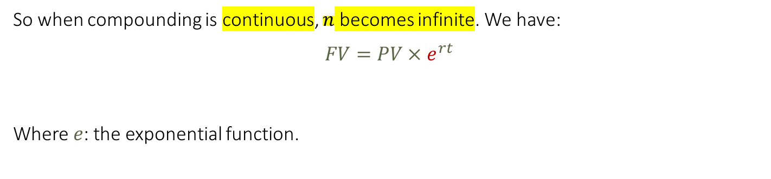
TVM – continuous compounding
So when compounding is continuous, $n$ becomes infinite. We have:
$$FV=PV×e^{rt}$$
Where $e$: the exponential function.
Example 2: a 10-year investment plan pays an annual interest rate of 2%, continuously compounded. What would be the future value of a £1,000 invested today?
$$FV=PV e^{rt}=1,000×e^{2\%×10}=£1,221.40$$

Slide 17


TVM formulae - Roundup
Simple interest
$$FV=PV×\left(1+rt\right)$$
$$PV=FV×{\left(1+rt\right)}^{−1}$$
Compound interest
$$FV=PV×{\left(1+r\right)}^{t}$$
$$PV=FV×{\left(1+r\right)}^{−t}$$
$${r=\left(\frac{FV}{PV}\right)}^{\frac{1}{t}}$$
$$t=\frac{\ln\left(\frac{FV}{PV}\right)}{ln⁡(1+r)}$$
- Continuous compounding
$$FV=PV×e^{rt}$$
$$PV=FV×e^{−rt}$$

Slide 18
Learning Outcomes Covered
Understand the concept of time in finance
The present value and discounting
The future value and compounding
Simple vs Compounding Interest
Notes:
The concept of time in finance
Simple vs Compounding Interest
The present value and discounting
The future value and compounding

Slide 19
Next Week
Time Value of Money part 2; Valuation of multiple cashflows, annuities and perpetuities as well as effective rates.

